Slide 1
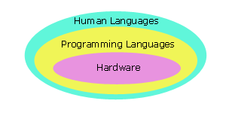
Programming Languages (1)

Slide 2
Programming Languages (2)
5 generations:
  Machine languages.
  Assembly languages.
  Third-generation languages. These are languages with instructions that describe how a result is to be obtained (C, Pascal, C++, Java…).
  Fourth-generation languages. These are languages with instructions that describe what is to be done without specifying how it is to be done (eg:SQL).
  Fifth-generation languages are the closest to human languages. They are used for artificial intelligence, fuzzy sets, and neural networks (eg: Prolog, Matlab)

Slide 3
Programming Languages (3)
The higher the level, the closer to the human languages and the further from native machine languages
  Each third generation language statement ~ 5-10 machine language statements.
  Each fourth generation language ~ 30-40 machine language statements.

Slide 4
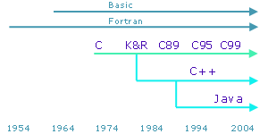
Programming Languages (4)
Popular third generation languages over the years have been Fortran, Cobol, Algol, Visual Basic, Pascal, C, C++ and Java. C++ and Java are built upon C syntax.
Popular fourth generation languages include SQL, Prolog and Matlab.

Slide 5
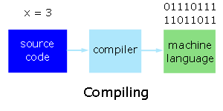
Interpreters and Compilers
When we code a program in a high level language, we write source code. We translate this code into machine language statements using either
  an interpreter, or
  a compiler.

Slide 6
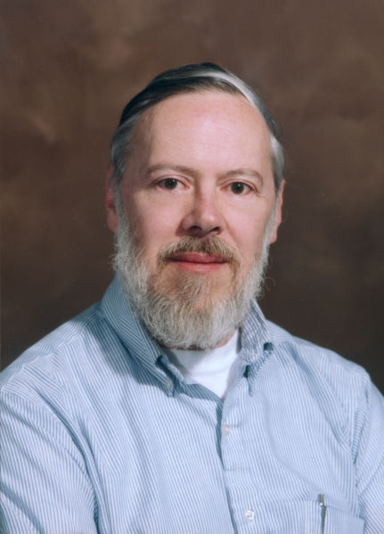

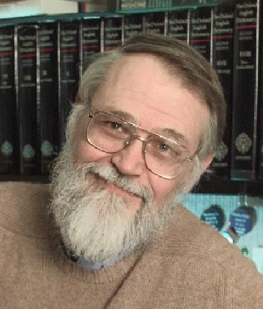
History of C
In 1970 Ken Thompson of Bell Lab developed B language (BCPL -Basic Combined Programming Language) used in UNIX operating system on DEC PD-7 computer.
1972 Dennis Ritchie and Ken Thompson developed C language from B language.
At the same time, Unix operating system was designed at Bell Lab and C was quickly used to re-write Unix (originally written in Assembly).
“The C Programming Language” was first published in 1978
Unix and C has become so popular till then.

Slide 7
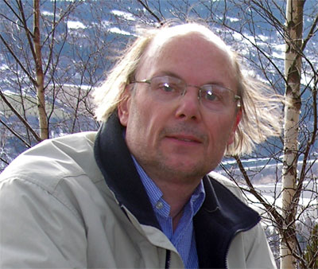
Objective-C & C++
Objective-C is an extension of C to support OOP programming paradigm.
Objective-C was developed by Brad Cox and Tom Love of StepStone company in early 1980s
Objective-C was used to develop NeXTStep operating system, which later became Mac OS X at Apple
C++ was developed by Bjarne Stroustrup between 1983-1986 at Bell Lab
C++ adds Object-Oriented Programming (OOP) support to C (i.e., preserving legacy C syntax) but now becomes a quite different programming language.
C++ becomes one of the most popular programming language today.

Slide 8
C versus JAVA
 | C | JAVA
DoB | 1972 | 1995
Programming Paradigm | Procedural | OOP
Memory Management | Programmer | Compiler
Standard Library | Limited | Huge
Portability | Good | Excellent*
Speed | Fast | Slow (run via JVM)**
Availability of Compiler | Free/Open-source | Free
Supported OS | Almost All | Limited (depend on Sun)
*Java source code is translated to Java Bytecode by Java compiler
**JVM is Java Virtual Machine which can run Java Bytecode

Slide 9
So Why Learning C?
C is very efficient, both in terms of speed and memory
  Better control of low-level mechanisms
  More predictable and faster than Java
  Small footprint: Ideal for embedded systems, portable devices
Lots of legacy code in C
  Many great programs have been written in C: BSD Unix, Linux kernel, vi, etc.
But great power comes with great responsibility
  Programmer has to be careful in using C as it is easy to make serious mistake which can result in insecure systems and programs.

Slide 10
Some Notable Features (1)
Comments
  /* */
  We use comments to document our programs and to enhance their readability. C compilers ignore all comments.
  // ....
  C++ compilers ignore the rest of current line after //.
Whitespace
  We use whitespace to improve program readability and to display the structure of our program's logic. C compilers ignore all whitespace

Slide 11
Some Notable Features (2)
Case Sensitivity
  C language is case sensitive.
  C compilers treat the character 'A' as different from the character 'a'

Slide 12
C LANGUAGE
Characteristics of C
• Small size
• Extensive use of function calls
• Loose typing -- unlike PASCAL
• Structured language
•Pointer implementation - extensive use of pointers for memory, array, structures and functions.

Slide 13
C Program Structure
Preprocessor Commands
Type definitions
Function prototypes -- declare function types and variables passed to function
Variables
Functions

Slide 14
Creating, Compiling and Running Your Program
Use any ordinary editor with which you are familiar to create the file
The filename must by convention end ``.c'' (full stop, lower case c), e.g. myprog.c

Slide 15
The C Compilation Model
Source code
Preprocessor
Compiler
Assembly code
Assembler
libraries
Object code
Link Editor
Executable code

Slide 16
The Preprocessor
The Preprocessor accepts source code as input and is responsible for
removing comments
interpreting special preprocessor directives denoted by #.
C Compiler
The C compiler translates source to assembly code
Assembler
The assembler creates object code

Slide 17
Variables
C type Size (byte)
char 1
Unsigned char 1
Short int 2
Unsigned short int 2
(long) int 4
float 4
double 8

Slide 18
Arithmetic Operations
Increment & Decrement operations
Postfix and Prefix expressions
example:- x++ is faster than x=x+1.

Slide 19
Order of Precedence
() [ ] -> .
* / %
+ -
< <= >= >
== !=
&
^
&&
||
,

Slide 20
CONDITIONALS
IF STATEMENT
? OPERATOR
SWITCH STATEMENT
break and continue
C provides two commands to control how we loop:
• break -- exit form loop or switch.
continue -- skip 1 iteration of loop

Slide 21
FUNCTIONS
returntype fn_name(₁, parameterdef₂,…)
{
localvariables
functioncode
}
VOID FUNCTIONS

Slide 22
Structures
Collection of different datatypes.
A structure is a user-defined data type.
A structure is a collection of one or more variables, possibly
of different types, grouped together under a single name
Eg: struct student
{
int rollno;
char name[10];
float marks;
} s ;

Slide 23
UNIONS
A union is a variable which may hold (at different times) objects of different sizes and types .
union number
{
short shortnumber;
long longnumber;
double float number;
}

Slide 24
* POINTERS
C uses pointers a lot. Why?:
• It is the only way to express some computations.
• It produces compact and efficient code.
• It provides a very powerful tool.
What is a Pointer?
A pointer is a variable which contains the address in memory of another variable .

Slide 25
Dynamic Memory Allocation
Dynamic allocation is a pretty unique feature to C .
It enables us to create data types and structures of any size and length to suit our programs need within the program.
malloc
calloc
realloc

Slide 26
FILES
Files are the most common form of a stream
Open a file:
FILE *fopen(char *name, char *mode)
fopen returns a pointer to a FILE.
*name ?? *mode ??
Reading and writing files
The functions fprintf and fscanf a commonly used to access files.
int fprintf(FILE *stream, char *format, args..)
int fscanf(FILE *stream, char *format, args..)

Slide 27
Basic String Handling Functions
strcmp
strcat
strcpy
strlen
strerror
strcasecmp

Slide 28
DATA STRUCTURES
Definition of data structures
• Many algorithms require that we use a proper representation of data to achieve efficiency.
• This representation and the operations that are allowed for it are called data structures.
• Each data structure allows insertion, access, deletion etc.

Slide 29
Why do we need data structures?
    • Data structures allow us to achieve an important goal: component reuse
    • Once each data structure has been implemented once, it can be used over and over again in various applications.

Slide 30
Common data structures are
• Stacks
    • Queues
    Lists
    Trees
    Graphs
    Tables

Slide 31
SORTING TECHNIQUES
Bubble sort
Quick sort
Insertion sort
Selection sort
Heap sort

